Slide 1
LEADERBOARD CLIMBING
HACKERRANK PROBLEM / C++

Slide 2
THE PROBLEM
You are given a list of leaderboard rankings along with scores.
A player wants to track their ranking, so he will provide a list of scores.
For each score, you must give the new player ranking.

Slide 3
THE PROBLEM
The player scores are strictly increasing (player keeps improving)
The rankings of the leaderboard are decreasing.
The game uses dense ranking : Starting with one, players with the same score have the same rank and the next score obtains the next incremental rank.

Slide 4
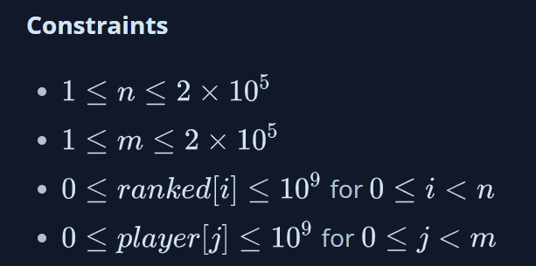
LIMITS

Slide 5
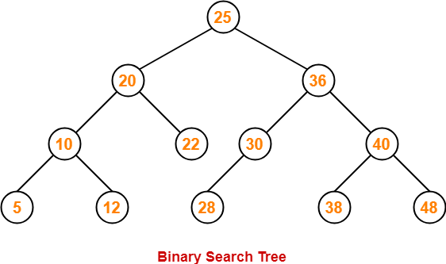
A “SOLUTION IDEA”
Let’s use binary search trees !

Slide 6
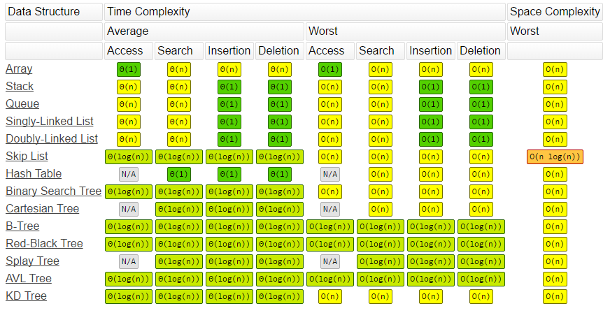

Slide 7
A “SOLUTION IDEA”
A node
Value (score)
Rank
Pointer to left node
Pointer to right node

Slide 8
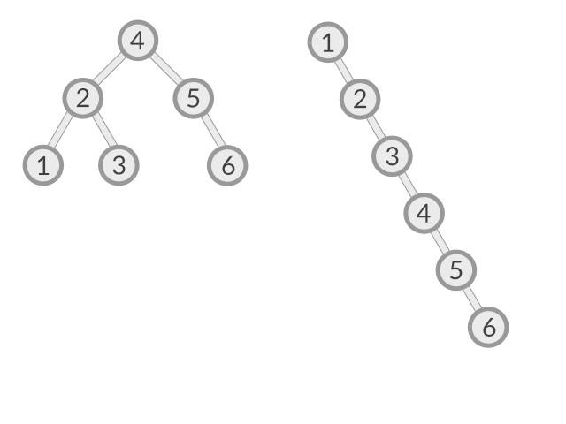
A “SOLUTION IDEA”
…Except : score are “sorted” so, we will end up with an unbalanced tree.

Slide 9
A “SOLUTION IDEA”
So, each node will be centered about its spanning range. We will start with the center score…

Slide 10
A “SOLUTION IDEA”
Then, to find the leaderboard ranking of the player, just binary search for the score, if found, return the ranking of that node, otherwise, if less, return ranking – 1, if greater, return ranking + 1.
(i.e. dense ranking)

